Slide 1
Natural Language Processing of ICB meeting minutes

Slide 2
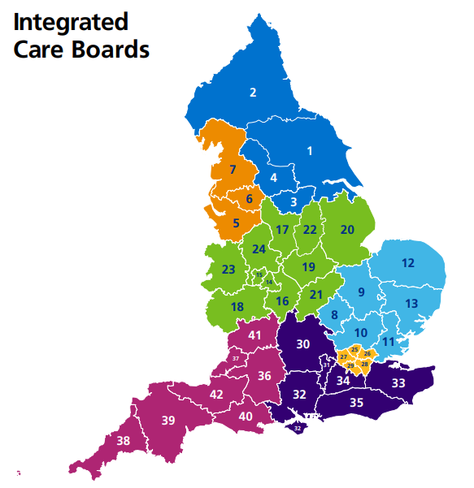
Context
Health and social care services are commissioned at the local level by Integrated Care Boards (ICBs).
Local authority leaders.
Councillors.
NHS leaders.
These boards regularly meet to discuss strategy, finance, risks and other issues.

Slide 3





Project aim
The Secretary of State wants to understand common and emerging issues and the overall focus of ICBs.
Develop an Natural Language Processing (NLP) based solution to monitor ICB meeting minutes
ICB meeting
Minutes
NLP system
ICS intelligence unit
SoS response

Slide 4
Challenges
Formatting is often specific to minutes and much text is non-informative:
Named entities (e.g. board members) are often abbreviated:
Context is often required to understand the topic being discussed:
3. Minutes of the previous meeting held on 15 December 2022
Approval: Naomi Eisenstadt
Reference: ICB-23-01
Comments CC acknowledged the work that the Lay Members did for the CCG and highlighted the spectrum of commissioning that the ICB does and supported BSs proposal. RW stated this is an example of how we can examine our back-office functions and streamline.
Janet Gray reported that detailed discussions had taken place in terms of forthcoming industrial action and the state of preparedness. A huge amount of preparation had gone on across the system, particularly with the single point operation centre.

Slide 5
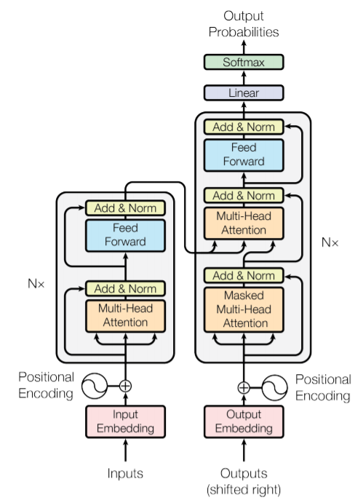
Solution
Large Language Model (LLM).
Can be found pre-trained.
Flexible to a number of tasks.

Slide 6
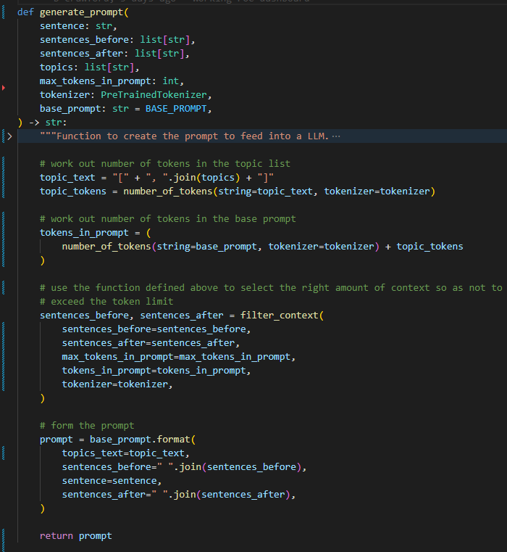
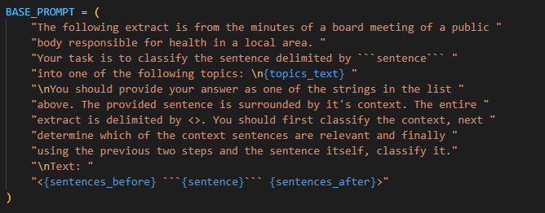
Technical details
FLAN-T5 deployed on AWS SageMaker (p3.2xlarge).
Encoder-decoder model.
Internal deployment addresses potential privacy concerns.
Best performing open-source LLMs for text summarisation.
Finetuned on instructions – saves prompt space.

Slide 7

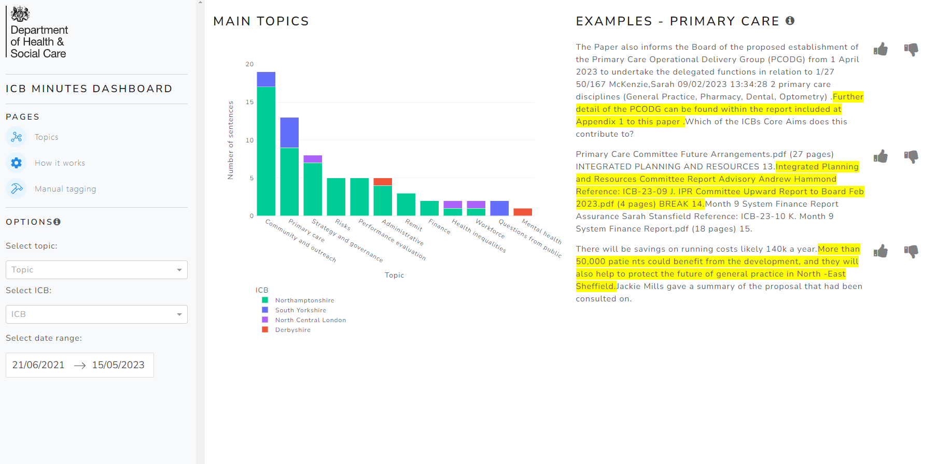
Product
Dashboard produced using Python (Plotly Dash).
User feedback to finetune the model.
Notes:
4:20

Slide 8
Next steps
Improve efficiency of processing to allow scale.
Adapt prompt to get deeper into issues of interest: e.g. highlighting all the instances of discussion of a measure to relieve UEC pressures.
Move onto testing with stakeholders:
Can this system reduce time spent on reading minutes and board papers?

